Slide 1
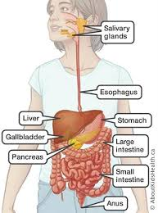
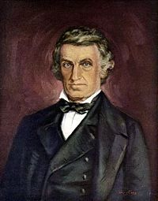
Catton Grove Primary School - Science
Year 4 | Topic: Digestion | Strand: Biology - Animals including humans
What should I already know?
The names of external parts of the body. About the importance of food for human survival. That children grow into adults and the changes that happen as a result. How important it is to eat the right amounts of different foods. That animals, including humans, need the right types and amount of nutrition. We cannot make our own food: we get nutrition from what we eat. How nutrients and food are transported within animals and humans. How to find out and describe the basic needs of animals and humans for survival.
Our Learning Objectives:
Describe the simple functions of the basic parts of the digestive system in humans.
Scientific Skills and Enquiry:
What is digestion?
Scientific Core Knowledge:
Food is our fuel, and its nutrients give our bodies' cells the energy and substances they need to work. But before food can do that, it must be digested into small pieces the body can absorb and use.The first step in the digestive process happens before we even taste food. Just by smelling that homemade apple pie or thinking about how delicious that ripe tomato is going to be, you start salivating — and the digestive process begins in preparation for that first bite. Almost all animals have a tube-type digestive system in which food: enters the mouth passes through a long tube exits the body as feces (poop) through the anus Along the way, food is broken down into tiny molecules so that the body can absorb nutrients it needs: Protein must be broken down into amino acids. Starches break down into simple sugars. Fats break down into into fatty acids and glycerol. The waste parts of food that the body can't use are what leave the body as feces.
Spotlight on a Scientist:
William Beaumont. William Beaumont, (born Nov. 21, 1785, died April 25, 1853, St. Louis, Mo.), U.S. army surgeon, the first person to observe and study human digestion as it occurs in the stomach.

Slide 2
Scientific Vocabulary:
anus: the end of the digestive system where unwanted food leaves the body
digestion: breaking down food
energy: used to help us move, grow and repair our body
incisor: a tooth for biting food, at the front of the mouth
large intestine: absorbs water and stores undigested food
mouth: where digestion starts and food gets into the body
nutrients: chemicals needed for growth, movement, repair and health in general
oesophagus: the scientific name for the food pipe
small intestine: the thin tube where broken down food is absorbed
stomach: a bag of muscle used in the first part of digestion
Misconceptions:
There are two tubes, one for food and another for drink. That the tube from the mouth stops at the stomach. That the digestive system covers every part of our bodies, with bits of food going directly to the legs to make you run, for example.
Fun Facts:
The average person produces 2 pints of saliva every day. ... The muscles in your esophagus act like a giant wave. ... The second part of your small intestine is called the jejunum. ... Enzymes in your digestive system are what separate food into the different nutrients that your body needs.

