Slide 1
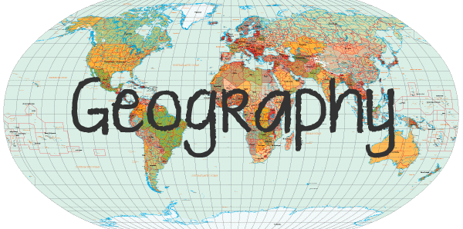
The study and understanding of the physical world and its people.

Slide 2
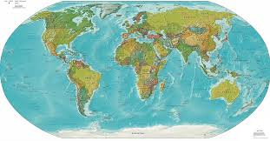
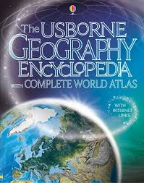
The world is made up of seven continents and five oceans.
Find the names of the continents and oceans using a map, an atlas or the internet.

Slide 3
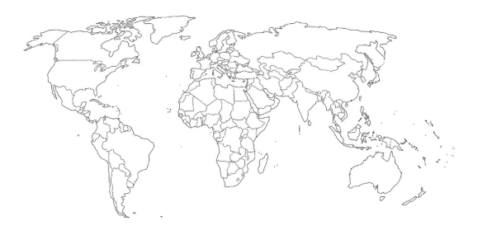
Once you have found their names, have a go at drawing their location on a flat version of a world map, like the one below.

Slide 4
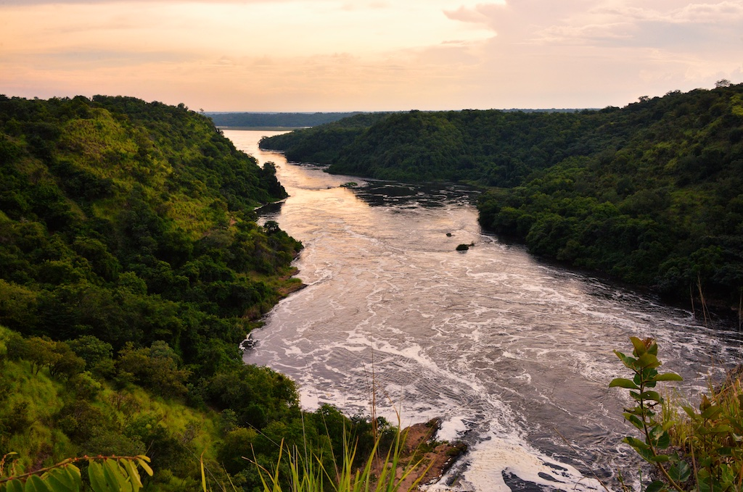
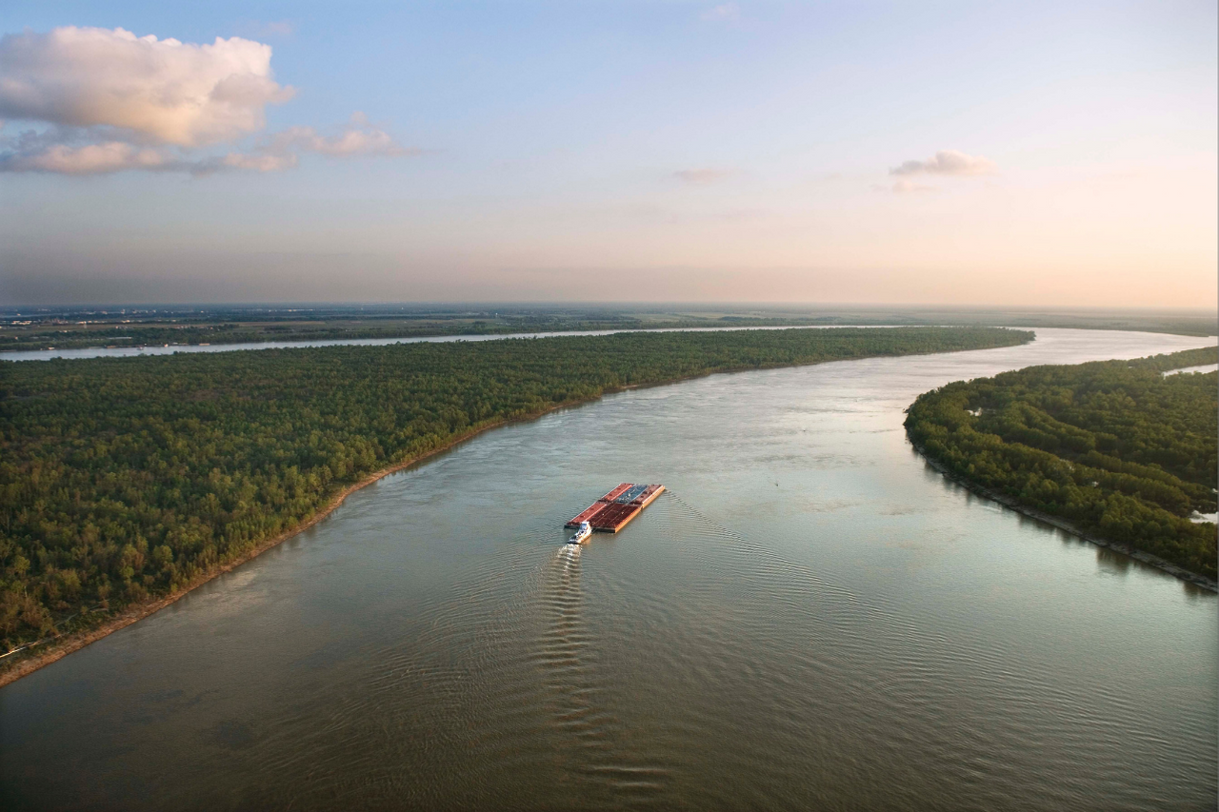
What are the names and locations of the major rivers of the world?

