Slide 1
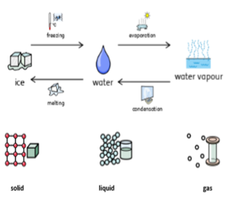
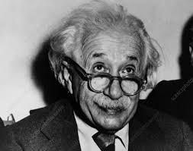
Catton Grove Primary School - Science
Year 4 | Topic: States of Matter | Strand: Physics
What should I already know?
Why some materials are used for certain purposes because of their properties. That a particle is a minute piece of matter. That a thermometer records temperature.
Our Learning Objectives:
Compare and group materials together, according to whether they are solids, liquids or gases. Observe that some materials change state when they are heated or cooled, and measure or research the temperature at which this happens in degrees Celsius (°C).
Scientific Core Knowledge:
- All matter exists as solids, liquids, or gases. These are called the states of matter. - Matter can change from one state to another if heated or cooled. - If ice (a solid) is heated it changes to water (a liquid). This change is called MELTING. - If water is heated, it changes to steam (a gas). This change is called BOILING. - The particles of ice, water, and steam are identical, but arranged differently.
Scientific Skills and Enquiry:
What are the properties of a solid, liquid or gas? If gases are invisible, how can we prove that they are there? What instruments and units are used to record temperature accurately? How the temperature of hot or cold water change over time? Can liquid turn into gas?
Spotlight on a Scientist:
Albert Einstein, (born March 14, 1879, Ulm, Württemberg, Germany—died April 18, 1955, Princeton, New Jersey, U.S.), German-born physicist who developed the special and general theories of relativity and won the Nobel Prize for Physics in 1921 for his explanation of the photoelectric effect.

Slide 2
Scientific Vocabulary:
boiling point: the temperature at which a liquid turns into a gas | matter: another name for ‘material’
boiling: when a material reaches a temperature when it bubbles and turns into a gas rapidly | material: what an object is made of (not just fabric)
condensing: the process when a gas turns into a liquid | melting: when a solid turns into a liquid
evaporation: when a liquid turns into a gas, below its boiling point | melting point: the temperature at which a solid melts
freezing: when a liquid turns into a solid | solid: a state of a material when it cannot change shape, but holds the shape of whatever container it was frozen in
freezing point: the same temperature as a material’s melting point. This is the temperature at which a liquid turns into a solid | temperature: a measurement of how hot or cold something is
gas: a state of a material when it fills the entire space available | thermometer: a device or instrument used to measure temperature
liquid: a state of a material when it can flow from one place to another, and can be poured | water cycle: how water moves around to create clouds, rain and the weather
Fun Facts:
Water is a very special substance. The Celsius temperature scale is based on the temperatures at which it changes to ice and steam – but what are these states? Not all solids are hard. Can you find examples that aren’t hard? Even the air around you can be a solid. But not with you alive in it! You would freeze to death, as air freezes at –215°C. That’s over 200° below the freezing point of water. When rocks get really hot they turn into a liquid called magma or lava.
Misconceptions:
That materials always exist in just one state. That ice is a different material from steam or liquid water, not water in different states. Soft things are not solids. Powders are not solids because they can be poured and take the shape of their container, e.g. sand and flour. That only water boils. That there aren’t temperatures below zero or above 100°C. That everything freezes at 0ºC
Investigate:

