Slide 1
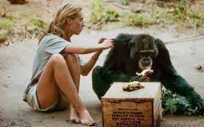
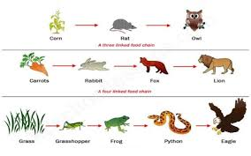
Catton Grove Primary School - Science
Year 4 | Topic: Producers, Predators and Prey | Strand: Biology - Animals including humans
What should I already know?
The difference between a herbivore, omnivore and carnivore. About the importance of food for survival. That animals, including humans, need the right types and amount of nutrition. How to find out and describe the basic needs of animals and humans for survival.
Our Learning Objectives:
Construct and interpret a variety of food chains, identifying producers, predators and prey.
Scientific Skills and Enquiry:
What is a predator? What is prey? What is a food chain? Why do cows have 2 stomachs? Why would an animal eat feces?
Spotlight on a Scientist:
Jane Goodall, in full Dame Jane Goodall, original name Valerie Jane Morris-Goodall, (born April 3, 1934, London, England), British ethologist, known for her exceptionally detailed and long-term research on the chimpanzees of Gombe Stream National Park in Tanzania.
Scientific Core Knowledge:
A food chain shows how each living thing gets its food. Some animals eat plants and some animals eat other animals. For example, a simple food chain links the trees & shrubs, the giraffes (that eat trees & shrubs), and the lions (that eat the giraffes). Each link in this chain is food for the next link.

Slide 2
Scientific Vocabulary:
carnivores: animals such as lions whose main way of getting food is to kill and eat other animals, or to scavenge their dead flesh | predator:an animal that naturally preys on others.
herbivore: animals such as cows that mainly eat plants | prey:an animal that is hunted and killed by another for food.
omnivores: animals, like you and me, that eat both plants and meat | food chain: a series of organisms each dependent on the next as a source of food.
Fun Facts:
Sound travels with a speed of 767 miles per hour but it cannot travel through a vaccum. The scientific study of sound waves is known as acoustic. These waves are also known as pressure waves because they push the particles they are passing through. Dogs can hear at a higher frequency as compared to humans.
Misconceptions:
That teeth grow continually. There are two tubes, one for food and another for drink. That the tube from the mouth stops at the stomach. That the digestive system covers every part of our bodies, with bits of food going directly to the legs to make you run, for example. That a predator can’t be prey. That only herbivores are prey. That humans aren’t predators or are not part of food chains.

