Slide 1
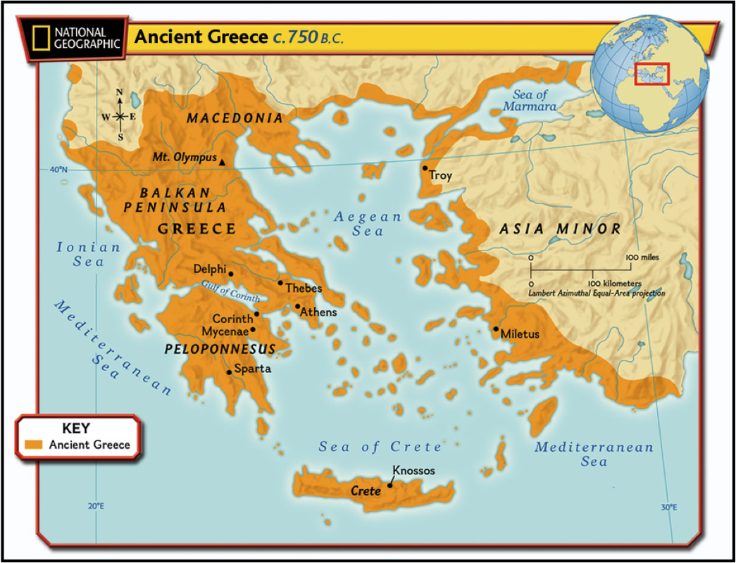
Catton Grove Primary School - History
Year 4 | Topic: Ancient Greeks | Strand: Chronology, Invasion & Resistance, Empire, Culture and Technology
What should I already know?
The chronology of British history. Britain from the Stone Age to the Iron Age. Information about the Egyptian civilisation. Greece is a country in the continent of Europe.
Diagrams:
Greece is made up of the mainland and many islands. Its position by the sea meant that the Greeks were a seafaring people. City-states (polis) were created and trade happened between each of the cities. Greece is a warm country, but winds from the Mediterranean, and rains from the north, kept temperatures liveable and created fertile farming conditions.
Core Knowledge for Ancient Greeks:
Greece was divided into polis, which each had their own laws and way of life, but they all spoke the same language. The two most well-known were Athens and Sparta. In Athens theatre, architecture and philosophy were developed, which helped shape modern society along with science, language and maths. They had a democratic government - this means that they made decisions by voting like in the UK. Life in Sparta was very different as all that was important was to be able to defend Sparta in battle. The first Olympic games were held in 776 in the polis of Olympia. Religion was very important in ancient Greece. They were polytheists, which meant they believed in many gods and goddesses. Each god and goddess was in charge of different parts of their lives. Temples were built in their honour and they featured heavily in the stories of Greek mythology. A polis consisted of an urban centre, often fortified and with a sacred centre built on a natural acropolis (citadel) or harbour.
Historical Skills and Enquiry:
Who were the Ancient Greeks? What was life like for the Ancient Greeks? What can we thank the Ancient Greeks for? What are Gods, myths and legends?

Slide 2
Historical Vocabulary:
Acropolis: the citadel of an ancient Greek city. | Fertile: rich in nutrients to support the growth of many plants.
Archeologist: someone who studies the past by exploring old remains. | Invasion: to try and take over a place by force.
Architecture: the art of planning, designing and constructing buildings. | Merchant: a person who buys or sells goods in large quantities.
Chronology: the order of events in time. | Military: relating to or belonging to the army.
Circa: Latin meaning ‘around’. c800BC means around 800BC. | Mythology: a group of myths, especially all the myths from a particular country, religion or culture.
Citadel: a strong building in or near a city, where people could shelter for safety. | Philosophy: the study or creation of theories about basic things such as the nature of existence, knowledge, and thought, or about how people should live.
Civilisation: a human society with its own special organisation and culture. | Polis: an ancient Greek city state.
Climate: the general weather conditions which are typical to a place. | Polytheists: the worship of or belief in more than one god.
Continent: a very large area of land that consists of many countries. Europe is a continent. | Seafaring: working as a sailor or travelling regularly on the sea.
Culture: activities such as the arts and philosophy, which are considered to be important for the development of civilisation. | Society: people in general, thought of as a large organised group.
Deity: a god or goddess. | Trade: the activity of buying, selling, or exchanging goods or services.
Democracy: a fair political system where all adults vote for an elected government. The government then makes decisions on how to run the country. | Urban: belonging to, or relating to, a town or city.
Empire: a number of individual nations that are all controlled by the government or ruler of one particular country. | Warfare: the activity of fighting a war.

