Slide 1
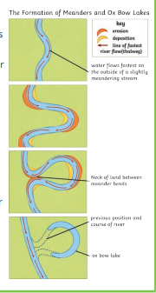
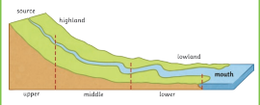
Catton Grove Primary School - Geography
Year 4 | Topic: Rivers | Strand: Human and Physical Geography
What should I already know?
The name and location of the world’s seven continents and five oceans. To know that a river is a large natural stream of water. To know that a stream is a small river. The water cycle.
Geographical Core Knowledge:
97% of all water on Earth is found in the oceans. The remaining 3% is fresh water, part of this small percentage includes rivers. A river has three stages - the upper course, the middle course and the lower stage. Rivers usually start (upper course) on high land - hills and mountains. High levels of rainfall feed the emerging river. In the middle course, rivers become wider and deeper. The land here becomes flatter. In the lower course of the river, the land is flat and the river is at its widest.
Scientific Skills and Enquiry:
How do the features of a river change along its course? What are the names and locations of the major rivers in the UK? What are the names and locations of the major rivers of the world? How do you use a compass to navigate?
Misconceptions:
Steam is visible. Steam and condensation are the same. Evaporation only occurs when water is boiling. Clouds are made of gas. Boiling/evaporation are irreversible changes.
Our Learning Objectives:
To locate and name the main rivers and seas of the UK and the world. To identify rivers and seas using an atlas or a map. To identify parts of a river. To use a compass to navigate. To understand the importance of rivers,

Slide 2
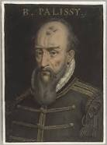
Scientific Vocabulary:
absorb: soak up or take in | liquid: in a form that flows easily and is neither a solid nor a gas.
atmosphere: the layer of air or other gases around a planet | precipitation: rain, snow, sleet, dew, etc, formed by condensation of water vapour in the atmosphere
condensation: small drops of water which form when water vapour or steam touches a cold surface, such as a window | runoff: rain in excess of the amount absorbed by the ground
evaporation: to turn from liquid into gas; pass away in the form of vapour. | surface: the flat top part of something or the outside of it
gas : a form of matter that is neither liquid nor solid. A gas rapidly spreads out when it is warmed and contracts when it is cooled. | transpiration: evaporation of water from a plant’s leaves, stem or flowers
groundwater: water that is found under the ground. Groundwater has usually passed down through the soil and become trapped by rocks. | water vapour: Water in the gaseous state, when due to evaporation at a temperature below the boiling point.
Spotlight on a Scientist:
The first published thinker to assert that rainfall alone was sufficient for the maintenance of rivers was Bernard Palissy (1580 CE), who is often credited as the "discoverer" of the modern theory of the water cycle.
Investigate at home:
Make a model of the water cycle. Look for examples of evaporation and condensation around your house. Draw and describe. Tell the story of a water droplet moving through the water cycle. Could you make it a poem?
Fun Facts:
Of all the water on earth, only 1% of it is suitable for human use. Water evaporates from the ground, turns into clouds, falls as rain, sleet or snow, and the whole process continues endlessly in a cycle. Plants can sweat, and the process is called transpiration – an essential part of the water cycle.

