Slide 1
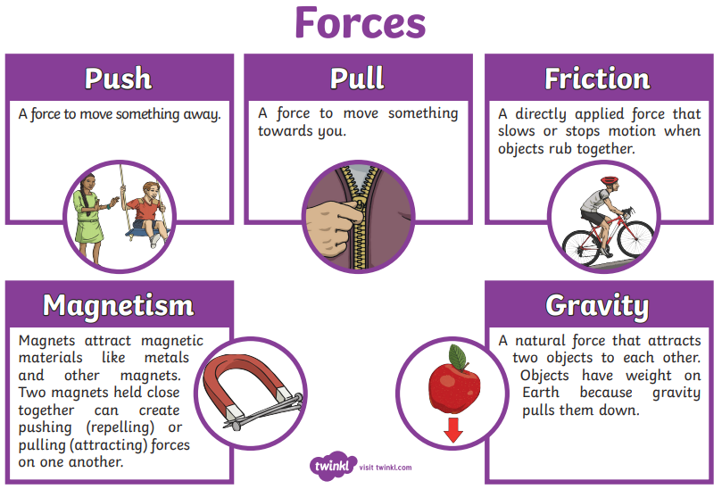
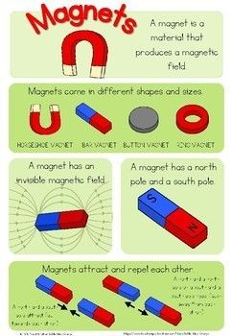
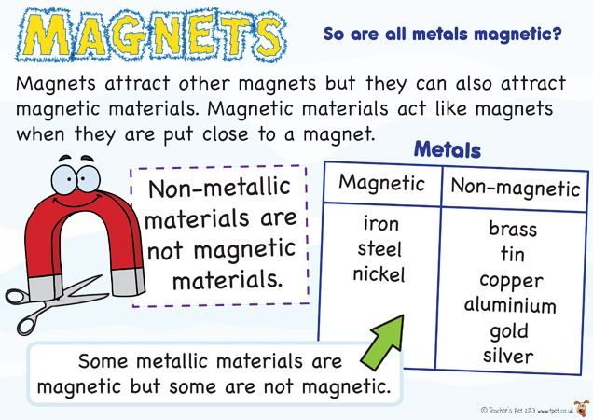
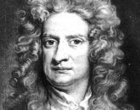
Catton Grove Primary School - Science
Scientific Key Knowledge
Year 3
Topic: Forces and Magnets
What should I already know?
You may know that magnets attract certain metals.
Our Learning Objectives:
Compare how things move on different surfaces.
Notice that some forces need contact between two objects, but magnetic forces can act at a distance.
Observe how magnets attract or repel each other and attract some materials and not others.
Compare and group together a variety of everyday materials on the basis of whether they are attracted to a magnet, and identify some magnetic materials.
Describe magnets as having two poles.
Predict whether two magnets will attract or repel each other, depending on which poles are facing.
Spotlight on a Scientist: Sir Isaac Newton
Isaac Newton was born in 1643 and became famous for his work on gravity and his three laws of motion. He was also well known for his work on light and colour, and what is now called calculus (a branch of mathematics).
The famous story of an apple falling to the ground from a tree illustrates how Newton's work on gravity was inspired by things he observed in the world around him.

Slide 2
Scientific Vocabulary
Misconceptions (Misunderstandings):
attract: pull towards
You might THINK:
that magnets stick to objects because they have magical properties.
that you can make a magnet out of all metals: in fact, they can only be made from iron, cobalt or nickel. that all metals are magnetic materials.
that all silver-coloured items are attracted to a magnet: this is false, aluminium is silver but is not attracted.
that larger magnets are stronger than smaller ones: this is also false, the size is not directly related.
that magnetic field and gravity are somehow linked: they are not.
that the Earth’s magnetic pole is fixed: in fact, it is constantly moving.
compass: a device that aids navigation by pointing to Earth’s North and South poles
contact: touching
force: a push, pull, twist or turn caused when two objects interact with each other
iron: a metal that can be made into a magnet
magnet: an object or device that attracts iron or another magnetic material
magnetic: attracted to a magnet
magnetic North: the direction of the Earth’s magnetic North pole
Fun Facts!
Magnets always have two poles -- even if you cut them in half
The Earth is like one big bar magnet. It has a magnetic north and a magnetic south, which is what the needle on a compass points to.
If you attach a bar magnet to a piece of wood and float it in a bowl of water, it will slowly turn and the magnet's North Pole will point towards the Earth's North Pole.
Magnets can be found in many common household items such as telephones, computers, fridges and TVs.
non-contact: not touching
non-magnetic: not attracted to a magnet
pole: the area of a magnet where the magnetic force is strongest
prediction: what you think might happen in a scientific test
repel: push away

