Slide 1
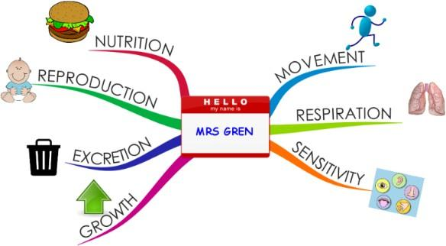
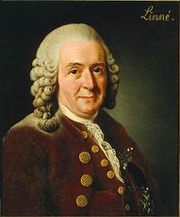
Catton Grove Primary School - Science
Year 4 | Topic: Habitats | Strand: Biology - Animals including humans
What should I already know?
That living things can be animals or plants. That a natural environment or the home of a variety of plants and animals is called a habitat. That living things can be divided into groups (vertebrates and invertebrates). The basic features of common animals and plants. That living things can be grouped based on their external features.
Our Learning Objectives:
Recognise that living things can be grouped in a variety of ways. Explore and use classification keys to help group, identify and name a variety of living things in their local and wider environment. Recognise that environments can change and that this can sometimes pose dangers to living things.
Scientific Skills and Enquiry:
How can living things be grouped? What is classification? How do environments change? What is a habitat? How can we help the environment?
Scientific Core Knowledge:
How living things can be grouped: All living things (organisms), have to do certain things to stay alive. These are the life processes: movement respiration sensitivity growth reproduction excretion Nutrition Living things can be grouped according to different criteria (where they live, what type of organism they are, what features they have). For example, a camel can belong in a group of vertebrates, a group of animals that live in the desert, and a group of animals that have four legs. How environments change: Habitats can change throughout the year and this can have an effect on the plants and animals that live there. Humans can have positive and negative effects on the environment: positive effects: nature reserves, ecological parks negative effects: litter, urban development
Spotlight on a Scientist:
Carolus Linnaeus (23 May 1707 – 10 January 1778) was a Swedish botanist, physician and zoologist who created the binomial nomenclature. In this system, every kind of animal and plant is given a name consisting of two Latin words, for its genus and species.

Slide 2
Scientific Vocabulary:
amphibian: an animal with an internal skeleton that lives both in and out of water. | insect: an animal with six legs
amphibian: an animal with an internal skeleton that lives both in and out of water. | invertebrate: an animal without a backbone.
centipede: an animal with one leg to each body segment. | key: a series of questions that helps identify or group / classify things
classify: to group things so that that they can be identified. | mammal: an animal that gives birth to live young.
fish: an animal with an internal skeleton that lives in water and has gills. | organism: a living thing, animal or plant.
flowering plant: one that produces pollen and seeds. | reptile: an animal with an internal skeleton that lays eggs, but lives on land.
habitat: the place where something lives. | vertebrate: an animal with a backbone.
Fun Facts:
A habitat is an area occupied by many species. A home is a place within a habitat where a particular animal species can protect itself and its young from the weather and predators. Microhabitats include the shady area under a tree and the underside of a rock in a stream. The oceans cover about 70 percent of the Earth’s surface, and form the largest of the world’s habitats. Deserts are very hot by day, but cooler at night. Few animals and plants have adapted to survive these difficult conditions. Habitats dominated by trees and shrubs are called forests. They include tropical rainforests, cool-climate coniferous forests, and temperate broad-leaved forests. These habitats all teem with life.
Misconceptions:
That trees aren’t plants. That insects aren’t animals. That there are only two groups of living things: animals and plants. That all ‘bugs’ are insects. That all ‘bugs’ are small.

