Slide 1
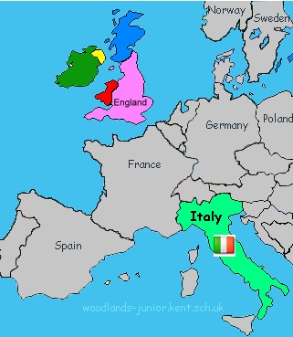
Catton Grove Primary School - History
Year 4 | Topic: Romans | Strand: Chronology, Invasion & Resistance, Empire, Culture and Technology
What should I already know?
The Stone Age was when early humans used tools from stone. This lasted until the Bronze Age. The Bronze Age began when settlers arrived from Europe to Britain. These settlers brought with them ways of making tools from metal. (bronze). The Iron Age was when people used tools made from iron. People learned to farm and began to build settlements.
Historical Skills and Enquiry
Who are where were the Romans? Why did Julius Caesar’s attempt of invasion in 55-54 BC fail? Why did the Romans invade Britain and why were they successful? How did Boudica try and resist the Roman invasion? What was the impact of ‘Romanisation’ on Britain?
Important People
Julius Caesar: (100-44 B.C.) A great soldier and general from Rome who invaded Britain twice. Augustus: Caesar’s nephew and the first Emperor of Rome. His birth name was Octavian, he changed it when he won the civil war that followed Caesar’s death. Claudius: (AD 10 – 54) Emperor who conquered Britain. He was murdered by his wife.
Diagrams
The Romans lived in Rome, a city in the centre of the country of Italy.
Important Facts
Rome was founded in 753BC by its first king, Romulus. It grew into a rich and powerful city during the next few hundred years. The Romans had a large and well organised army. The Roman Empire grew and took over much of Europe, North Africa and the Middle East. In August 55 B.C. and 54 B.C. (55 years before Jesus was born) the Roman general, Emperor Julius Caesar invaded Britain twice. Almost 100 years later Emperor Claudius organised the successful Roman invasion of Britain in 43AD, which at the time was ruled by the Celts. Some accepted the invasion, others like Boudicca, leader of the Iceni tribe, resisted invasion. It took about 4 years for the Romans to gain control of Southern England and another 30 years for them to conquer larger areas in England and Wales. The Romans remained in Britain from 43 AD to 410 AD (almost 400 years. They left Britain because their homes in Italy were being attacked. The Romans play an important part in our lives even today, many things we do originated from the Romans. Our language, the calendar, laws, the Census (a way to keep track of people in a large area), roads, central heating, concrete and aqueducts are all legacies of the Roman invasion of Britain. The Romans came to Britain nearly 200 years ago and changed our country. Even today evidence of the Romans being here can be seen in the ruins of Roman buildings, forts, roads and baths all over Britain.

Slide 2
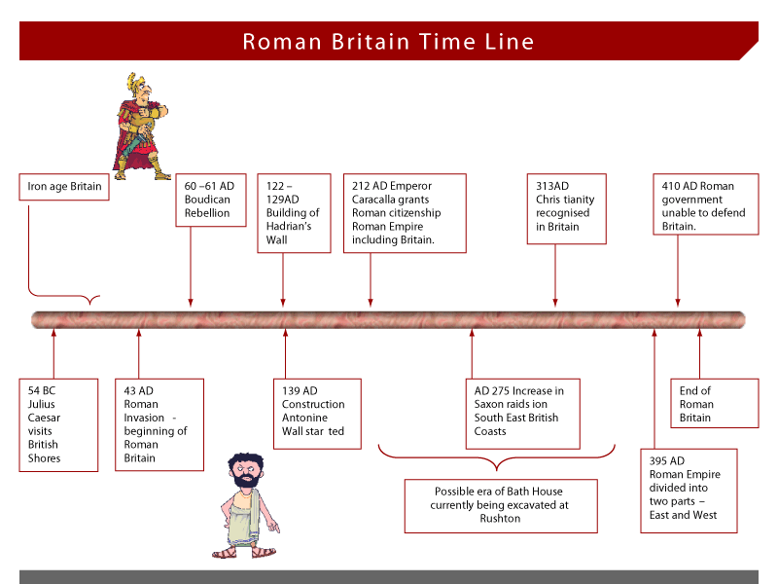
Historical Vocabualry
AD: stands for Anno Domini. It is a Medieval Latin term. It means "in the year of our lo.
Amphitheatre: an open circular or oval building with a central space surrounded by tiers of seats for spectators, for the presentation of dramatic or sporting events.
Aqueduct: an artificial channel for conveying water, typically in the form of a bridge across a valley or other gap.
Barbarian: (in ancient times) a member of a people not belonging to one of the great civilizations (Greek, Roman, Christian).
Basilica: a large oblong hall or building
Centurion: the commander of a century in the ancient Roman army.
Colosseum: a large theatre, cinema, or stadium.
Conquered: (of a place or people) having been overcome and taken control of by military force.
Empire: an extensive group of states or countries ruled over by a single monarch, an oligarchy, or a sovereign state.
Gladiator: (in ancient Rome) a man trained to fight with weapons against other men or wild animals in an arena.
Invasion: an instance of invading a country or region with an armed force.
Toga: a loose flowing outer garment worn by the citizens of ancient Rome, made of a single piece of cloth and covering the whole body apart from the right arm.
Roman Timeline:

